Slide 1
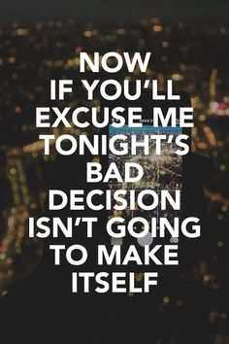
Human Decision Making
Bob Marshall, MD MPH MISM FAAFP
Program Director, DoD/MAMC Clinical Informatics Fellowship
Heavily edited by David Alt for personal notes

Slide 2
Learning Objectives
Review Decision-Making
Location in the brain
Environmental influences
Problem analysis versus decision-making
Group and individual decision-making processes
Decision-making models
Biases
Myers-Briggs and decision-making

Slide 3
Overview
Decision-making is a “problem-solving activity with a mutually acceptable solution”
Can be rational or emotional, based on implicit or explicit knowledge
Involves analysis of a finite set of alternatives described in terms of evaluative criteria.
Logical decision-making is an important part of all science-based professions, where specialists apply their knowledge in a given area to make informed decisions.
Research shows that in situations with higher time pressure, higher stakes, or increased ambiguities, experts may use intuitive decision-making rather than structured approaches.

Slide 4
Brain Mapping
Frontal lobe - regulates decision making, problem solving, control of purposeful behaviors, consciousness & emotion
Parietal lobe - receives & processes sensory information from the body. Also is where letters from words & words themselves combine into thoughts
Temporal lobe - regulates memory, emotions, hearing, language & learning
Cerebellum - regulates the initiation & timing of movement; important for maintaining balance & posture. Also helps modulate the force, steadiness & range of movement

Slide 5
Environmental Influences
Environmental complexity: factor that influences cognitive function.
A complex environment: environment with a large number of different possible states which come and go over time.
More complex environments correlate with higher cognitive function, which means that a decision can be influenced by the location.
In complex environment studies, cognitive function was greatly affected by the higher measure of environmental complexity, making it easier to think about the situation and make a better decision.

Slide 6
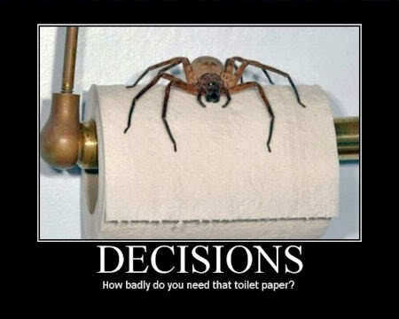

Slide 7
Problem analysis versus Decision-Making
Characteristics of problem analysis
Analyze performance: what should the results be against what they actually are
Problems are merely deviations from performance standards
Problems must be precisely identified and described
Problems are caused by change from a distinctive feature
Something can always be used to distinguish between what has and hasn't been affected by a cause
Causes of problems can be deduced from relevant changes found in analyzing the problem
Most likely cause of a problem is the one that exactly explains all the facts (or explains more of the facts than any other potential cause)

Slide 8
Problem analysis versus Decision-Making 1 of 2
Characteristics of decision-making
Objectives must first be established
Objectives must be classified and placed in order of importance
Alternative actions must be developed
The alternatives must be evaluated against all the objectives
The alternative that is able to achieve all the objectives is the tentative decision

Slide 9
Problem analysis versus Decision-Making 2 of 2
Characteristics of decision-making
The tentative decision is evaluated for more possible consequences
Decisive actions are taken, and additional actions are taken to prevent any adverse consequences from becoming problems and starting both systems (problem analysis and decision-making) all over again
There are generally followed steps that result in a decision model, and that model can be used to determine an optimal production plan
In a situation featuring conflict, role-playing may be helpful for predicting decisions to be made by involved parties

Slide 10
Analysis Paralysis
Analysis paralysis is the state of over-analyzing (or overthinking) a situation so that a decision or action is never taken; in effect paralyzing the outcome/ever achieving the outcome

Slide 11
Information Overload
Information overload: a gap between the volume of information and the tools we have to assimilate it.
Excessive information affects problem processing and tasking, which affects decision-making.
Crystal C. Hall and colleagues described an “illusion of knowledge”, meaning that as individuals encounter too much knowledge, it can interfere with their ability to make rational decisions.

Slide 12
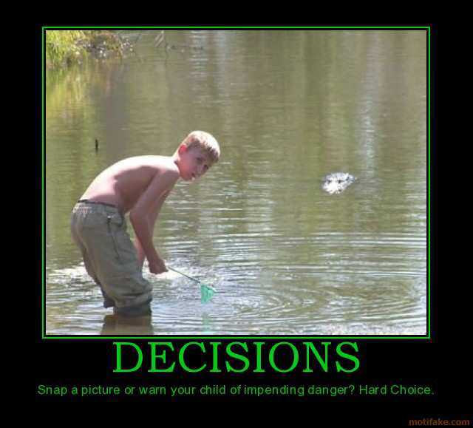

Slide 13
Group Decision-Making Techniques
Consensus decision-making tries to avoid “winners” and “losers”.
Voting-based methods
Majority requires support from more than 50% of the group members.
Plurality: where the largest block in a group decides, even if it falls short of a majority.
Range voting lets each member score one or more of the available options.
Delphi method is a structured communication technique for groups
Dotmocracy is a facilitation method that relies on the use of special forms called Dotmocracy Sheets
Participative decision-making occurs when the decision-making process is opened to a group of people for a collaborative effort.
Decision engineering uses a visual map of the decision-making process based on system dynamics

Slide 14
Individual Decision-Making Techniques
Decisional balance sheet: pros/cons of each option – equivalent to military brief “analysis of alternatives” / COAs
Simple prioritization: of options based on objective criteria
Satisficing: accept the first solution that meets the objectives, regardless of efficiency/cost/etc (“That which suffices is satisfactory”)
Acquiesce to a person in authority or an “expert“
Anti-authoritarianism: do the opposite of the recommended action (“Don’t trust anything the pediatrician says”)
Flipism: methods are based on randomness/coincidence (e.g. flipping a coin)
Automated decision support: set up criteria for automated decisions
Decision support systems: simple or complex (usually computer-based) systems to help with the decision process

Slide 15
Steps in Decision-Making
Multiple models exist
GOFER, 1980’s by Leon Mann
DECIDE, 2008 by Kristina Guo
Seven-step model by Pam Brown, Swansea, Wales
Eight-step model by John Pijanowski, University of Arkansas
U Mass/Dartmouth Model (seven steps)

Slide 16
DECIDE Model – 2008, Kristina Guo
Define the problem
Establish or Enumerate all the criteria (constraints)
Consider or Collect all the alternatives
Identify the best alternative
Develop and implement a plan of action
Evaluate and monitor the solution and examine feedback when necessary

Slide 17
Dartmouth/U Mass Model
Identify the decision - Try to clearly define the nature of the decision you must make
Gather information - Collect some pertinent information before you make your decision
Identify alternatives - identify several possible paths of action, or alternatives
Weight the evidence – imagine what it would be like if you carried out each of the alternatives to the end; place the alternatives in a priority order, based upon your own value system
Choose among alternatives - select the alternative (or combination of alternatives) that seems to be the best one for you
Take action - begin to implement the alternative you chose
Review your decision - consider the results of your decision and evaluate whether or not it has resolved the need you identified in Step 1

Slide 18
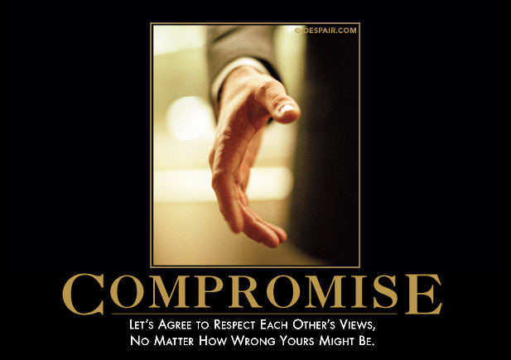

Slide 19
Rational versus Irrational
It is thought that if humans are rational and free to make their own decisions, then they would behave according to rational choice theory
Rational choice theory says that a person consistently makes choices that lead to the best situation for himself or herself, taking into account all available considerations including costs and benefits
The rationality of these considerations is from the point of view of the person himself, so a decision is not irrational just because someone else finds it questionable.
In reality, however, there are some factors that affect decision-making abilities and cause people to make irrational decisions

Slide 20
Cognitive and Personal Biases
Biases usually creep into decision-making processes
Selective search for evidence (also known as confirmation bias): People tend to be willing to gather facts that support certain conclusions but disregard other facts that support different conclusions.
Premature termination of search for evidence: People tend to accept the first alternative that looks like it might work
Cognitive inertia: unwillingness to change existing thought patterns in the face of new circumstances.
Selective perception: People actively screen out information they do not think is important
Wishful thinking: tendency to want to see things in a certain – usually positive – light, which can distort perception and thinking.
Choice-supportive bias: occurs when people distort their memories of chosen and rejected options to make the chosen options seem more attractive.

Slide 21
Cognitive and Personal Biases cont.
Recency: People tend to place more attention on more recent information and either ignore or forget more distant information
Repetition bias: willingness to believe what one has been told most often and by the greatest number of different sources
Anchoring and adjustment: Decisions are unduly influenced by initial information that shapes our view of subsequent information
Groupthink: peer pressure to conform to the opinions held by the group
Source credibility bias: tendency to reject a person’s statement on the basis of a bias against the person, organization or group to which the person belongs
Incremental decision-making and escalating commitment: People look at a decision as a small step in a process, and this tends to perpetuate a series of similar decisions.

Slide 22
Cognitive and Personal Biases cont.
Attribution asymmetry: attributing one’s own success to internal factors, including abilities and talents, but explain one’s failures in terms of external factors such as bad luck
Role fulfillment: tendency to conform to others’ decision-making expectations
Underestimating uncertainty and the illusion of control: People tend to underestimate future uncertainty because of a tendency to believe they have more control over events than they really do
Framing bias: best avoided by increasing numeracy* and presenting data in several formats
Sunk-cost fallacy – involves an individual making a decision about a current situation based on what they have previously invested in the situation
Prospect theory: idea that when faced with a decision-making event, an individual is more likely to take on a risk when evaluating potential losses, and are more likely to avoid risks when evaluating potential gains.
Optimism bias: tendency to overestimate the likelihood of positive events occurring in the future and underestimate the likelihood of negative life events
*Numeracy complements literacy and is sometimes called ‘mathematical literacy’

Slide 23
Influence of Myers-Briggs Type
According to Isabel Briggs Myers, a person’s decision-making process depends to a significant degree on their cognitive style
Myers developed a set of four bipolar dimensions, called the Myers-Briggs Type Indicator (MBTI)
The terminal points on these dimensions are: thinking and feeling; extroversion and introversion; judgment and perception; and sensing and intuition
A person’s decision-making style correlates well with how they score on these four dimensions
For example, someone who scored near the thinking, extroversion, sensing, and judgment ends of the dimensions would tend to have a logical, analytical, objective, critical and empirical decision-making style
Research has found that American, Japanese and Chinese business leaders each exhibit a distinctive national style of decision-making

Slide 24
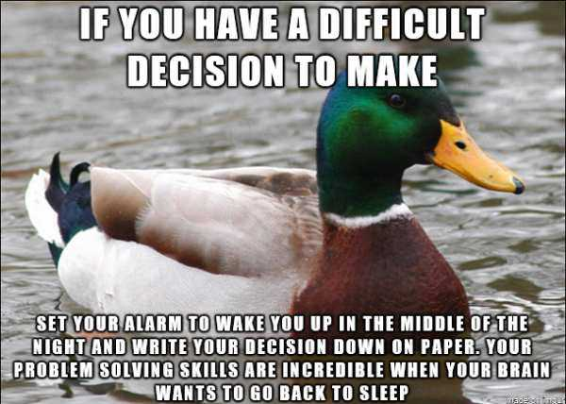
Questions

